Slide 1
Algorithmic Composition of Two-Part First Species Counterpoint
By: Ryan Yonek

Slide 2
Table of Contents
Species Counterpoint
First Species Example
Machine Learning
Neural Networks
Magenta
Implementation
Results
References for Images

Slide 3
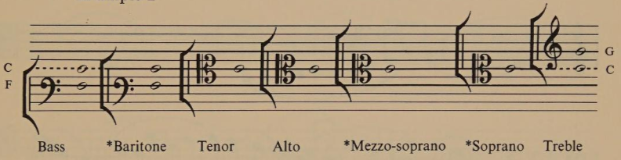
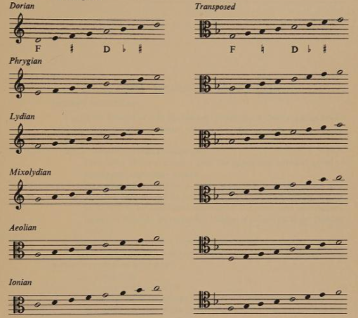
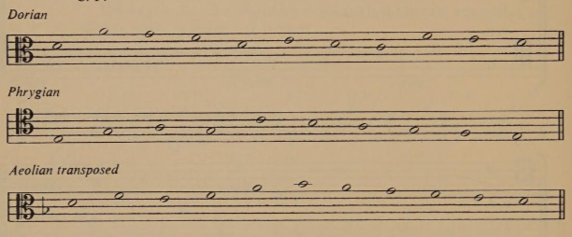
Species counterpoint
C Clefs
Cantus Firmus
Church Modes

Slide 4
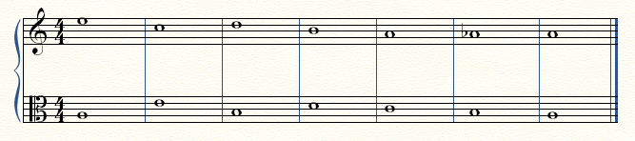
First Species Example

Slide 5
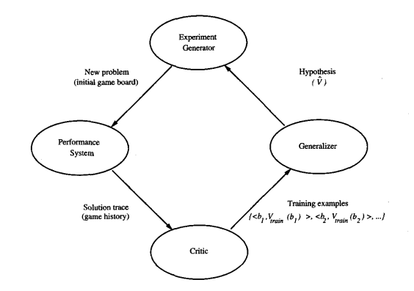
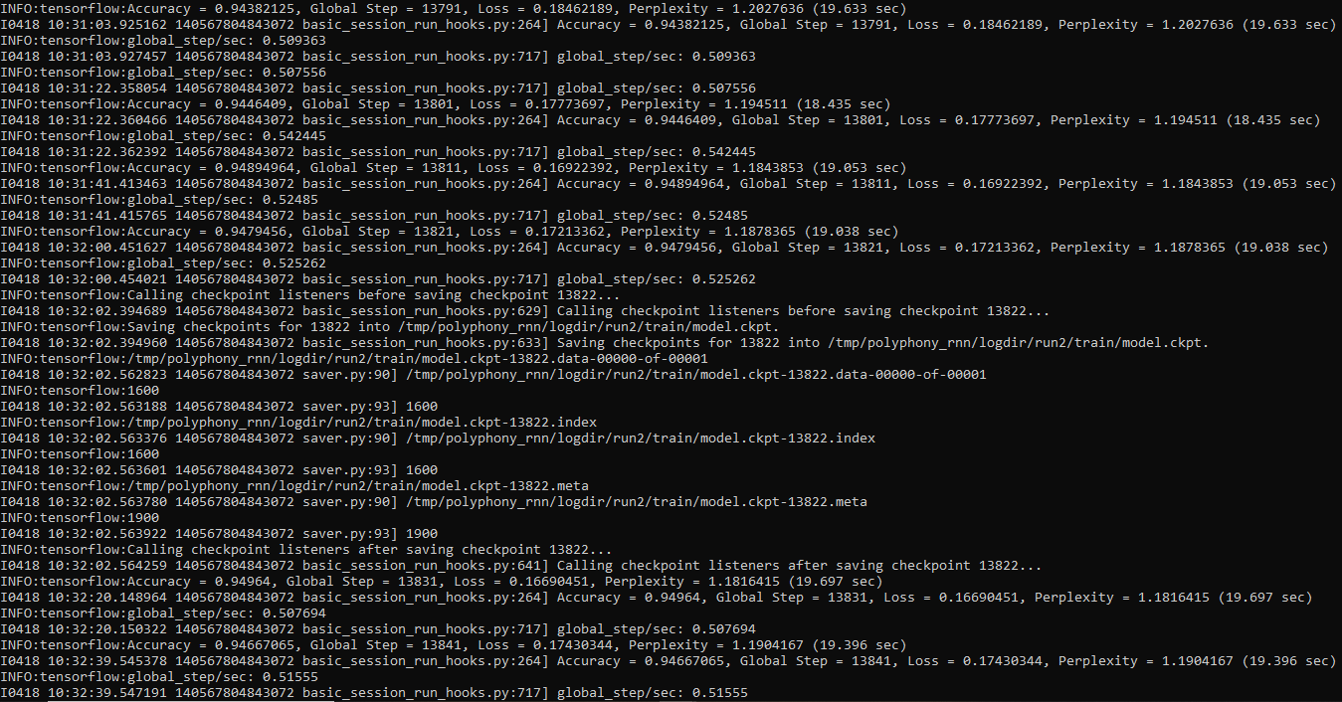
Machine Learning

Slide 6
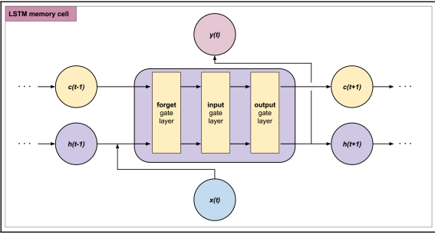
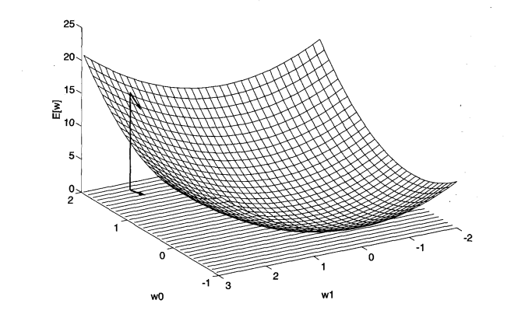
Neural Networks
Biological
Perceptron
Training
Gradient Depth
Back Propagation

Slide 7
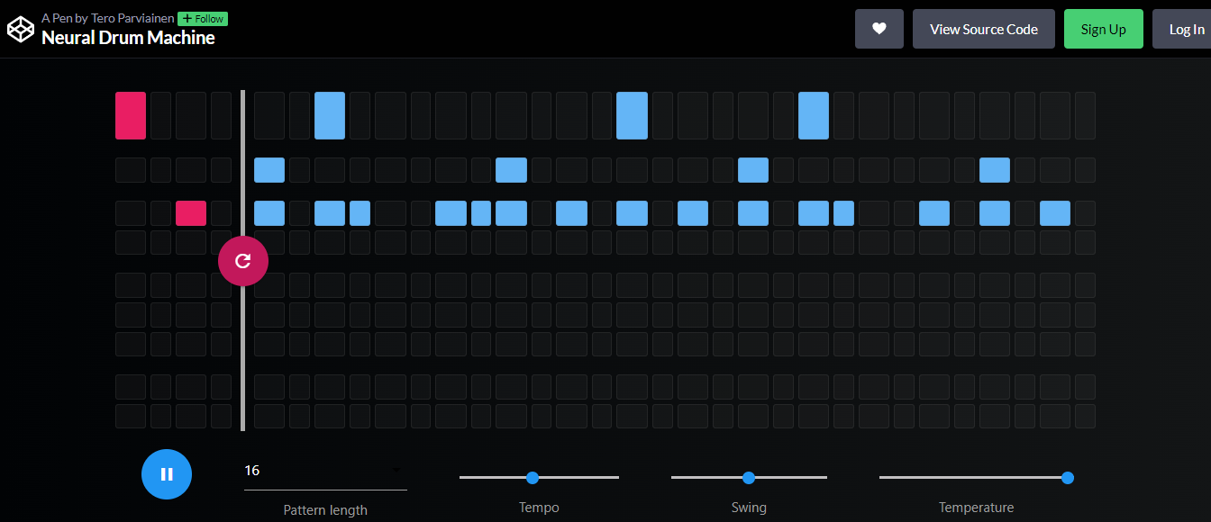
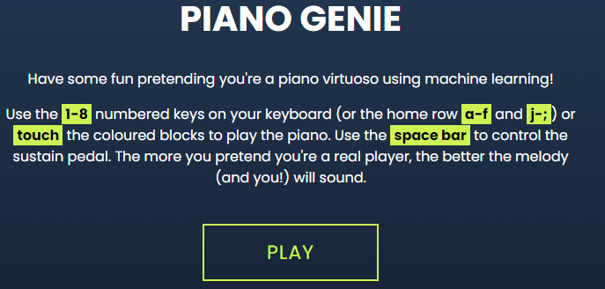

Magenta
Open Source
RNNs
LSTMs
VAE
GAN

Slide 8
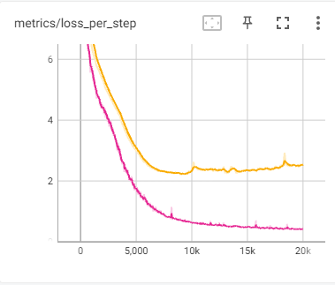
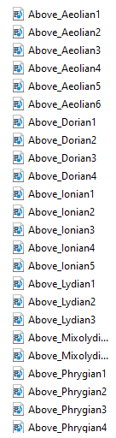
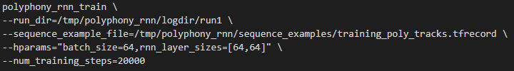
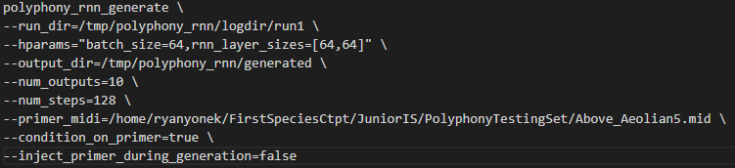
Implementation

Slide 9
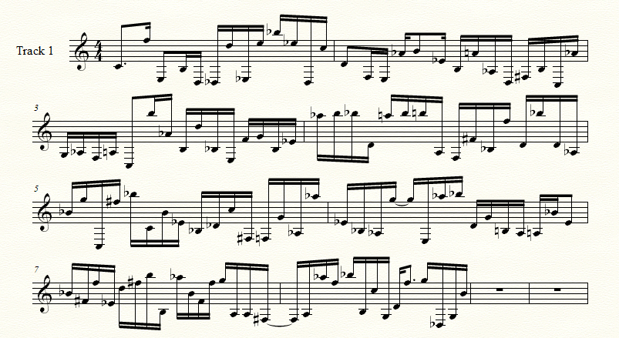
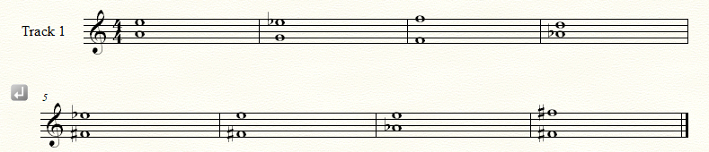
Results

Slide 10
References for Images
https://codepen.io/teropa/full/JLjXGK
https://piano-genie.glitch.me/
file:///C:/Users/ryany/Downloads/9781838824419-HANDSON_MUSIC_GENERATION_WITH_MAGENTA.pdf
https://www.cs.cmu.edu/~tom/files/MachineLearningTomMitchell.pdf
https://github.com/magenta/magenta
https://archive.org/details/handbookofmodalc0000robe

